Slide 1
Norton’s Theorem
Any two terminal’s consisting of linier resistances and independent sources may be replaced with current source and parallel resistance

Slide 2
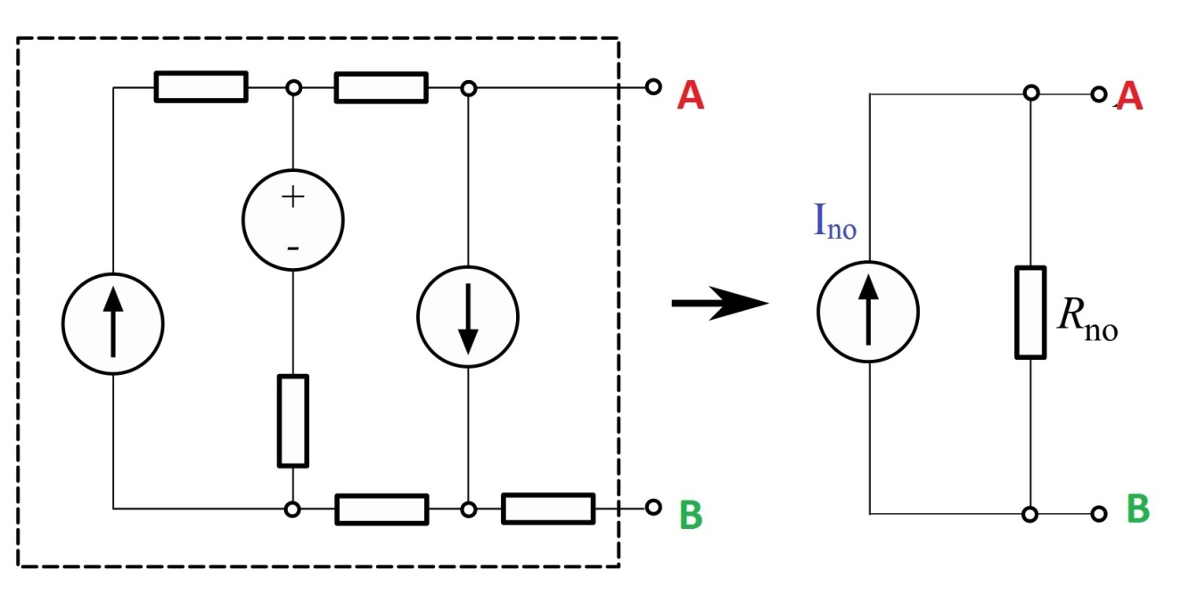

Slide 3
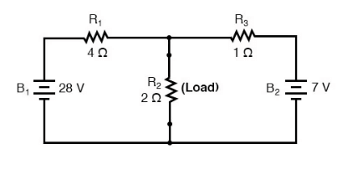
Taking an example of an electric circuit:
This consists of three branches of electric al resistances and two sources of voltage

Slide 4
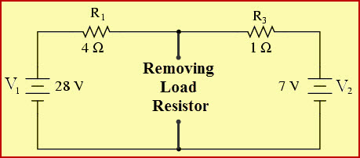
To find Norton,s equivalent of above circuit
We first remove the centre 2 ohm load and short out terminals.
When shorted, the two resistances become parallel across two respective voltages.
The current through this shorted arm is short circuit current
Let’s understand with an example.
I₁=28V/4 ohm I₃=7V / 1 ohm
I_{s}=I₁+I₃ that is I_{s}=7+7= 14 A

Slide 5
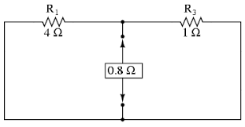
When two voltage circuits are open circuited ,the two Resistances are connected in parallel. The value of equivalent Resistance is
R_{S}=R₁R₃/R₁+R₃
R_{S}=4x1 /4+1= 0.8 ohm

Slide 6
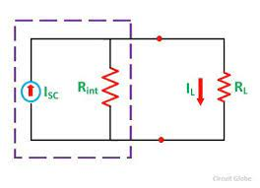
R_{T}=R_{s}xR_{L}= 0.8 x 2 = 1.6 ohmNow Voltage across two shorted terminals is
V_{ab} = 1x 1.6=1.6
And current through load is
I = 1.6/R_{L}

